Slide 1
Exploring The Potential of Digital Twin Technology for Enhancing Online Shopping Experience
Κινητή και Διάχυτη Υπολογιστική
Μάιος 2023

Slide 2
Team Members
Ευθυμίου Βασίλειος,ics21035
Αναστάσιος Ελευθεριάδης, ics22135
Ευστάθιος Ιωσηφίδης, iis21027
Παναγιώτης-Φώτιος Μαυρομάτης, ics21073
Τζελαλής Γεώργιος, ics21032

Slide 3
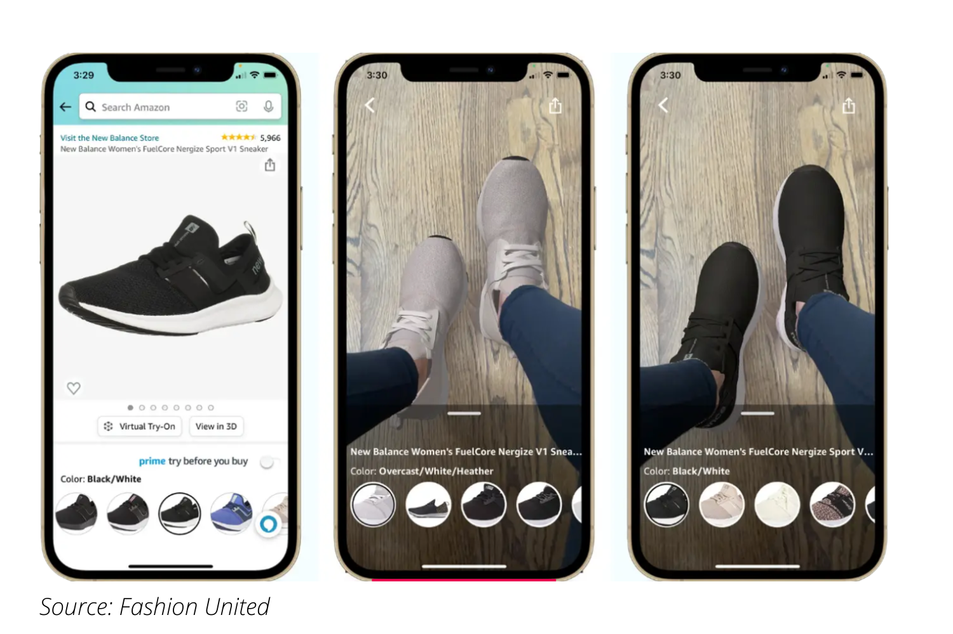
Περίληψη Ιδέας-Κίνητρο

Slide 4

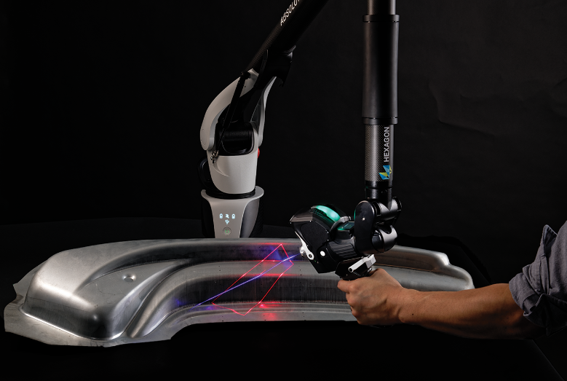

Μεθοδολογία
Digital Twins,Machine learning and data collection

Slide 5
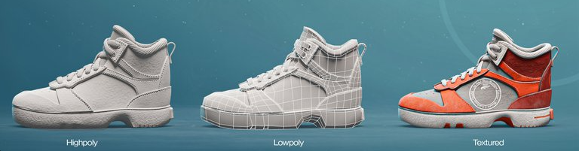
Μεθοδολογία
3D Modeling

Slide 6
Μεθοδολογία
AR/VR Implementation
Notes:
It is estimated that there will be 1.73 billion augmented reality users on mobile by 2024 (TechJury)
70% of consumers think that AR can provide them with benefits (TechJury)
57% of customers say they are more likely to buy from a brand if they are using AR (XR today)
AR eCommerce experiences are 200% more engaging when compared to their non-AR counterpart (ThreeKit)
Despite its benefits, only 15% of online retailers are using AR

